Slide 1
Collaboration Toolbox Two Concepts
Situational Leadership

Slide 2
Choosing appropriate leadership style for individuals with different competencies
Collaboration Toolbox
Situational Leadership
Definition
All information on slides created by: Paul Hersey, Ken Blanchard, and Seth Godin Copyright © 1979, 1998, 1993, 2001 by the Center for Leadership Studies, Inc. All rights reserved.

Slide 3
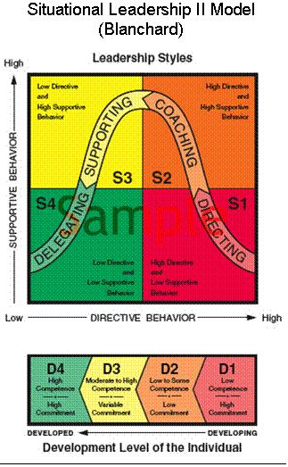
Collaboration Toolbox Situational Leadership Overview
Effective leaders will adapt their leadership style to the situation.
Team Members also adapt their developmental style to fit the situation

Slide 4
Collaboration Toolbox
Situational Leadership
Concept
Leaders adapt style according to the team member’s needs
What is the current competency level for the specific task I am asking the team member to perform?

Slide 5
Collaboration Toolbox
Situational Leadership
Concept
Situational Leadership
Ability Willingness
Knowledge of Task
Individual’s or Team’s
Experience and Proficiency
Confidence
Commitment
Motivation
for Executing Assigned Task

Slide 6
Collaboration Toolbox Situational Leadership Directing
High task focus, low relationship focus
Leaders
Define Roles and Tasks for Team
Close Supervision of members
Leader makes Decisions and Manages
For team members who lack competence, but are enthusiastic and committed and need direction and supervision to execute the task.

Slide 7
Collaboration Toolbox Situational Leadership Coaching
High task focus, high relationship focus
Leaders still define roles and tasks
Seeks ideas and suggestions from the team member.
For team members who have some competence but lack commitment, need support and praise to build their self-esteem, and involvement in decision-making to restore their commitment.

Slide 8
Collaboration Toolbox Situational Leadership Supporting
Low task focus, high relationship focus
Leaders facilitate and take part in decisions
Team member exerts some control over the task
For team members who have competence, but lack confidence or motivation and do not need much direction because of their skills, but support is necessary to bolster their confidence and motivation.

Slide 9
Collaboration Toolbox Situational Leadership Delegating
High Competency High Commitment
Leaders are involved in decisions and problem-solving
Team member controls execution of task
For team members who have both competence and commitment and are able and willing to work on a project by themselves with little supervision or support.

Slide 10
Collaboration Toolbox Situational Leadership How the SL Model Relates to TKI
TKI is an indicator of how you naturally manage your conflicts
While Situational Leadership is an indicator of how you naturally manage your team
Understanding team dynamics
Conscious of own behavioral patterns
Adapt leadership style to meet
team expectations and accomplish project goals

Slide 11
Collaboration Toolbox Situational Leadership Trends in changes of behavior 2013
Leadership Style:
Most did not change style (3/5) when change occurred, shifted towards low-directive
Team Motivation:
A) Shift towards high commitment as competence increased
or
B) Shift towards low commitment, as enthusiasm diminished
Notes:
Note: (as competence and commitment increased)

Slide 12
Collaboration Toolbox Situational Leadership Chocolate River Project
Designing a Bridge

Slide 13
Collaboration Toolbox Situational Leadership Chocolate River Project Instructions
Time: 30 minutes
Each Team will be given the following materials
Package of linguine
2. Glue Gun for Team
3. Glue sticks
4. Measure for the bridge span

Slide 14
Collaboration Toolbox Situational Leadership Chocolate River Project instructions
Team of 3 or 4 - All must participate
First Rotation Project Leader is in charge and will assign tasks.
Find a space to build your bridge
Design your bridge
Rules
Build for strength
Must Span 8.5 inches
b. Must be free standing until demonstration.
c. Cannot be taped to the floor, walls or other structures.
Implement

Slide 15
Collaboration Toolbox Situational Leadership Chocolate River Project Objective
Prizes Will Be Awarded on the Basis of the
Strongest Bridge
Most Aesthetically Pleasing Bridge

Slide 16
Collaboration Toolbox Situational Leadership Chocolate River Project Discussion
What did you observe?
1. How well did the team work together?
2. What do you think of your accomplishment?
3. What role did each team member play doing the task?
4. What skills did each member bring to the task?
5. What leadership styles did the team leader use during the planning?
6. What leadership styles did the team leader use during implementation?
7. Did you effectively communicate with each other?

Slide 17
Collaboration Toolbox Situational Leadership Conclusions
Teams do moderately well at adapting leadership style to team needs
Different situations require different leadership styles
Effective leaders account for team members’ levels of commitment and competence
Leadership style may alter across team members

Slide 18
Collaboration Toolbox Situational Leadership Suggestions for Improvements
Leaders choose a style that enhances members’ effectiveness
To Improve management assess team members’ ability and willingness to implement the task
Use appropriate Situational Leadership style
Directing
Coaching
Supporting
Delegating
Avoid conflicts through improved communication and negotiation

